Slide 1

FHIR Guidelines Library
CSC302 - Team J
S
H
D
ames
tew
enry
aniel

Slide 2

Overview:
What is it?
What it does
Why it matters?
Key decisions
What is success?
Learnings
Notes:
@henry

Slide 3
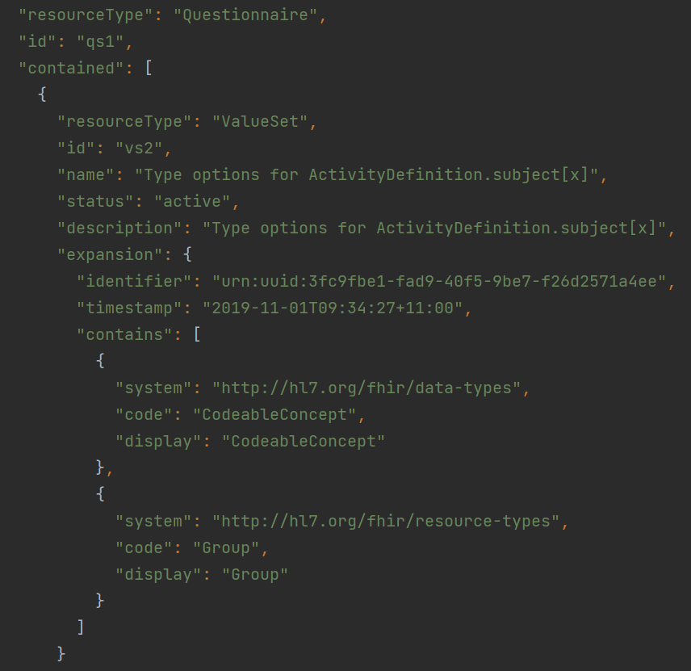
What is our project about?
Create a library for medical guidelines.
The medical guidelines should be of “FHIR” format.
Goal is to allow other applications to retrieve these guidelines from our service.
Backend-focused, no real front-end but includes documentation in readme.
Notes:
@henry

Slide 4
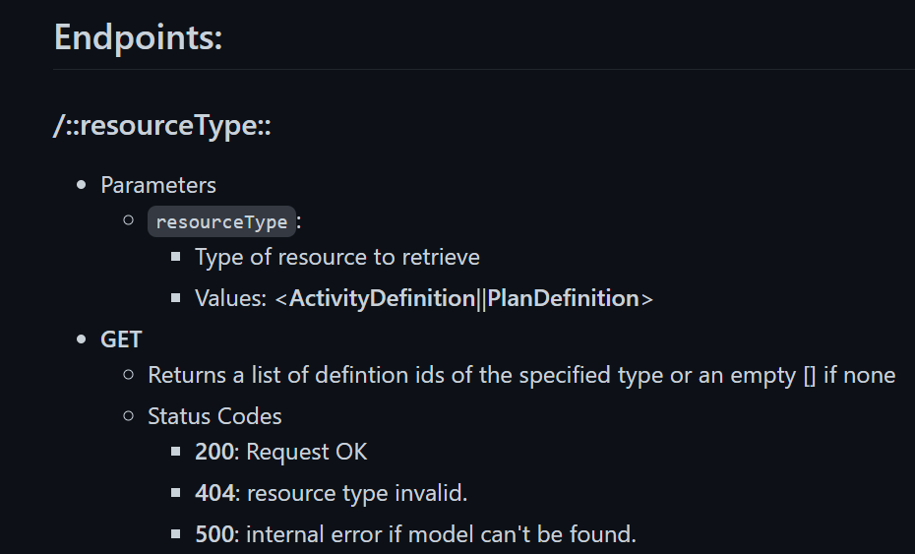
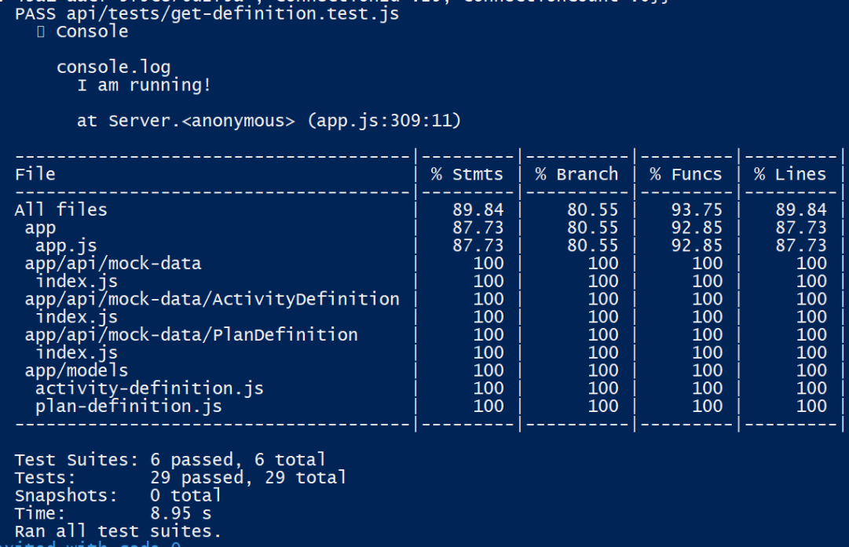
What did we do?
It was a backend service with a few features:
Adding a new guideline to the library
Listing names of all available guidelines.
Getting the detailed definition of a guideline in json format
Updating the contents of a guideline.
Deleting a guideline from our database.
Unit tests and integration tests for each of these features.
Notes:
@henry

Slide 5

What did we do?
It was a backend service with a few features:
Adding a new guideline to the library
Listing names of all available guidelines.
Getting the detailed definition of a guideline in json format
Updating the contents of a guideline.
Deleting a guideline from our database.
Unit tests and integration tests for each of these features.
Notes:
@henry

Slide 6
What did we do?
It was a backend service with a few features:
Adding a new guideline to the library
Listing names of all available guidelines.
Getting the detailed definition of a guideline in json format
Updating the contents of a guideline.
Deleting a guideline from our database.
Unit tests and integration tests for each of these features.
Notes:
@henry

Slide 7
What did we do?
It was a backend service with a few features:
Adding a new guideline to the library
Listing names of all available guidelines.
Getting the detailed definition of a guideline in json format
Updating the contents of a guideline.
Deleting a guideline from our database.
Unit tests and integration tests for each of these features.
Notes:
@henry

Slide 8
What did we do?
It was a backend service with a few features:
Adding a new guideline to the library
Listing names of all available guidelines.
Getting the detailed definition of a guideline in json format
Updating the contents of a guideline.
Deleting a guideline from our database.
Unit tests and integration tests for each of these features.
Notes:
@henry

Slide 9
What did we do?
It was a backend service with a few features:
Adding a new guideline to the library
Listing names of all available guidelines.
Getting the detailed definition of a guideline in json format
Updating the contents of a guideline.
Deleting a guideline from our database.
Unit tests and integration tests for each of these features.
Notes:
@henry

Slide 10
What did we do?
It was a backend service with a few features:
Adding a new guideline to the library
Listing names of all available guidelines.
Getting the detailed definition of a guideline in json format
Updating the contents of a guideline.
Deleting a guideline from our database.
Unit tests and integration tests for each of these features.
Notes:
@henry

Slide 11
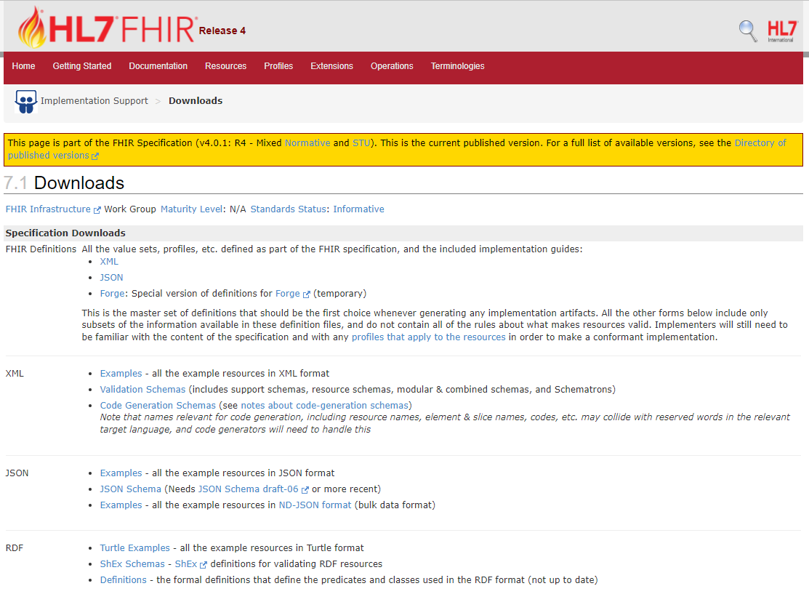
Why does it matter?
Target audience is other apps trying to access guideline data in with API requests
The best place to get this guideline data is on a downloads page on the FHIR site
Other apps can’t easily fetch this data nor can they keep up to date without redownloading
Our server allows easy access to guideline data with basic CRUD operations
Notes:
@daniel

Slide 12




Key Decisions - Project Start
General goals:
Want to minimize costs since this is not a project we’re expecting to support long term
Concerns about the time that this course will take up, so any reductions in development/setup time is favoured
Concerns that our workload from other courses will be high
Preference to use familiar knowledge and tech stacks if applicable to save time and minimize risk
Node.js backend + MongoDB database
Easy integration with mongoose between backend and db
Effective for unstructured data formats (e.g. JSON)
Jest Unit Testing
Self contained, does not require other dependencies
Notes:
@daniel

Slide 13
Key Decisions - Project Execution
Expanding Scope
Decided that the intended project scope was small
Added Create, Update and Delete as core features to our roadmap
Included several suggestions from our business partner
Added version tracking on site and records after Updates and Deletes
Added listing related objects to our roadmap as a stretch goal
Process Improvements
Assignment 2
Decided to have weekly group meetings in addition to the
TA meetings
Assignment 3
Decided to assign soft deadlines to group members for
blocking roadmap items
Notes:
@daniel

Slide 14
Testing and Validation criteria
The acceptance criteria were used for each feature involved in the milestones
“I should be able to ________ to _________ .”
Unit tests act as a checklist for the acceptance criteria
Integration tests were involved with the final milestone
Specific edge cases were defined for the criteria to reduce ambiguity
Notes:
@James

Slide 15
What is success?
Satisfying the acceptance criteria is the measure of success for the project
The acceptance criteria was reviewed with the industry partner
Aligns expectations between the team and the client
Each team member was assigned with a clear yes/no responsibility to easily monitor progress of the project
Notes:
@James

Slide 16
Retrospectives: What was learned?
How to properly run a meeting
Note Takers
Kept Short and to the Point
DevOps
Docker
Heroku
Testing
Integrated Testing
Jest, Supertest
Shortcomings of test frameworks
Notes:
@Stew

Slide 17
Retrospectives: Adjustments
Improved Communication
More Frequent Meetings
Daily Updates (started towards end of semester)
Better Time Management
Pushed a lot of work to last week
Less work more frequently
Partly due to busy school semesters.
Notes:
@Stew

Slide 18
Conclusions
Developing the FHIR Guidelines Library taught us so many things:
Software Design Process
DevOps
Communicating with Client
We believe our project met all the goals we wanted to reach.
Fantastic learning opportunity
Thank You!
Notes:
@Stew

